Slide 1

Credit card Customer report
Overall Performance
• Customers are making good income which facilitates more spending resulting into strong interest earnings for the company.
• However, the customer satisfaction score indicates there is a need for improvement in the service quality.

Slide 2
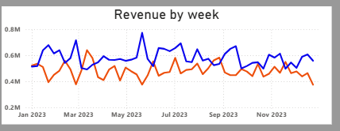

Credit card Customer report
Revenue Trend and Gender-wise Contribution
• Male customers consistently generate more revenue than the female customers.
• Male customers contribute to 55% of total revenue.

Slide 3
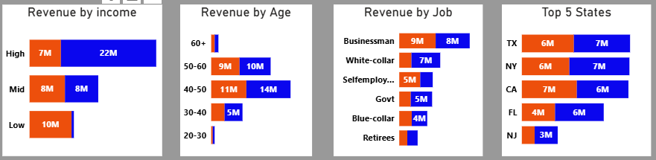
Credit card Customer report
Revenue by Categories
• Businessmen and White-collar workers are key revenue drivers.
• Women in low income group surprisingly seems to contribute more than the other groups i.e. $10M, possibly due to higher credit usage.
• Middle aged customers (40-60) are the most profitable segments.
•Texas, New York and California are the most profitable states.

Slide 4
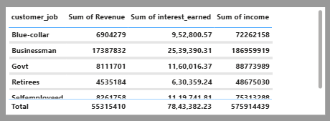
Credit card Customer report
Job based summary
• Businessmen are the highest income earners which is $186.96M.
• They are also the highest interest paying class i.e. $25.53M.

Slide 5
Credit card Customer report
Recommendations
• The company is performing well in terms of business but the customer satisfaction score indicates a higher chance of customer churn which is bad for business in the long run.
• Service quality needs to improved to stay ahead of competition. We have to re-look at the fees charging strategy, bring more transparency in the billing process and re-evaluate our reward policy. We also need to strengthen our customer support team and enhance the digital experience of our customers. We can also start a referral program for customers.
• Targeted marketing campaigns aimed at our middle aged (40-60) premium customers located in Texas, New York and California states who are businessmen, businesswomen and men doing white collar jobs by giving them perks and custom services. Give more offers to women in low income groups as they are willing to use credit card more often than cash.

Slide 6

Credit card Transaction report
Overall Performance
• Overall performance of the business is showing :
-> Strong Revenue of $55M.
-> High volume of transactions i.e. 656K.
-> Significant interest earnings of $7.84M.

Slide 7
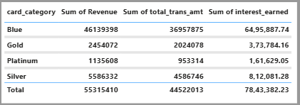
Credit card Transaction report
Card Category Performance
• Blue cards dominate this category with:
-> Revenue of $46.13M.
-> Transaction Amount of $36.96M.
-> Interest earned up to $6.49M.

Slide 8
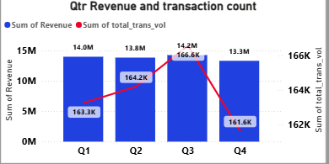
Credit card Transaction report
Quarterly Trend
• Revenue remained fairly consistent across quarters ($13M - $14M)
• However, the third quarter was the peak in terms of revenue and card usage, possibly due to the festive season.

Slide 9
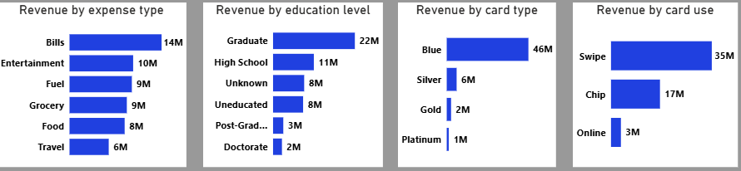
Credit card Transaction report
Revenue by Categories
• Most of the transactions are done for bill payments i.e. $14M.
• Well educated people are the most who do the transactions, maybe because they are more financially literate and tech savvy.
• Blue cards are the most popular among users as it has been profitable by a wide margin of $46M.
• It looks like physical use of card (Swipe/ chip) is more preferred than online usage.

Slide 10
Credit card Transaction report
Recommendation
• Targeted marketing campaign towards educated/ working people who are blue card holders.
• Give more offers like discounts or reward points to them on bill payments.
• Give exclusive offers to users during the festive season as they tend to spend more during these times.
• Tie-up with stores and restaurants where users most likely use the card for swipe payments where we can enhance their shopping or dining experience for every swipe payment made by them. This way we can increase our customer base organically in the long run.

